Slide 1


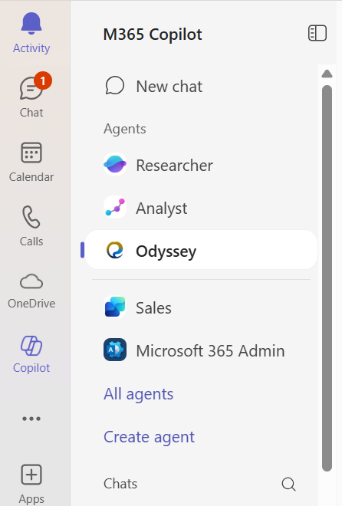
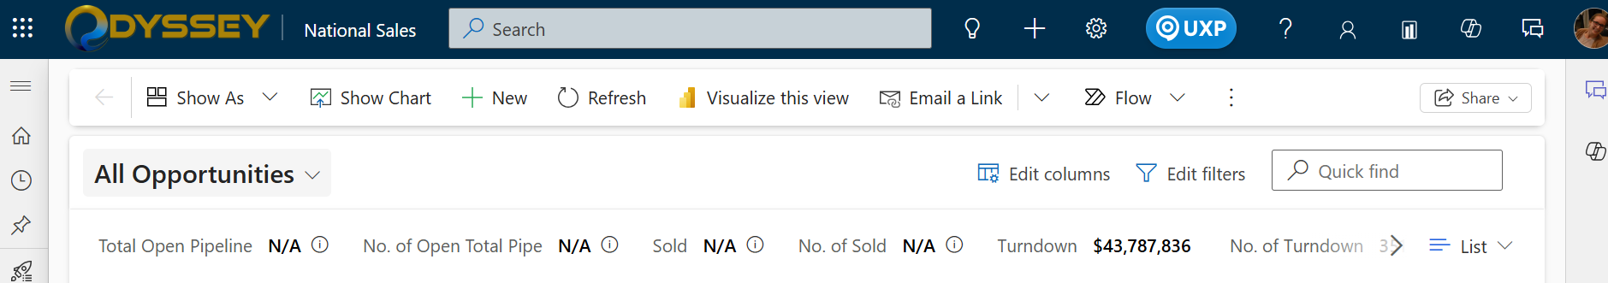
Self-Help Resources
Odyssey CoPilot:
CoPilot Agent trained on all of our materials that you can chat with to get answers to your questions live.
Odyssey ClickLearn:
Contains videos, guides, FAQ and Glossary for the CRM system.
Digital Workplace Ticket:
Support request used to report issues, request system changes, or get technical assistance for Odyssey.

